Slide 1
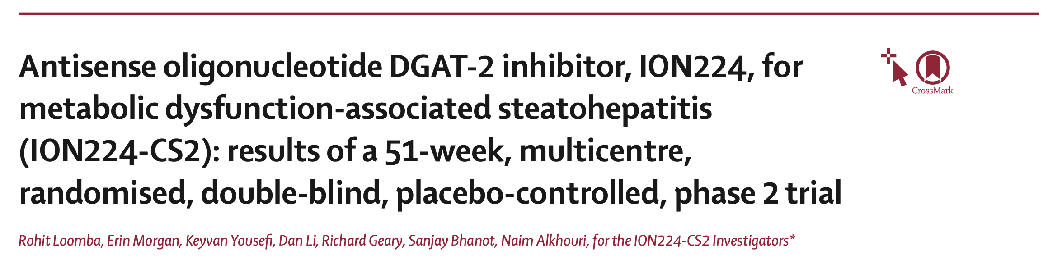
Oral presentation
December 12, 2025

Slide 2
  Introduction
Lancet (IF 88,5), August 23, 2025
Phase 2 adaptative multicentre randomised control trial (Level of evidence B), double-blind
43 centers
Population : adults with Metabolic dysfunction-associated steatohepatitis (MASH) and fibrosis, with steatosis ≥10%
Investigational drug : ION224, liver-directed antisense inhibitor of diacylglycerol O-acyltransferase 2 (DGAT2)
Aim of the study : safety and efficacy of ION224 for MASH and fibrosis

Slide 3
  Introduction
Study design
Interim analysis at 13 weeks, N = 50
- Safety
- Liver steatosis
- Liver transminases
Inclusion criteria :
18-75 years, BMI ≥ 25
Liver steatosis ≥ 10%
MASH histologic diagnosis
Exclusion criteria :
Other liver disease
Liver decompensation
Illicit drugs or alcohol
HIV, HBV, HCV active infection
Use of concomitant medications
Placebo
ION224 60 mg
Placebo
Phase 1
Random 3:1
Phase 2
Random 2:1
ION224 90 mg
ION224 90 mg
ION224 120 mg
ION224 120 mg

Slide 4
  Methods
Endpoints
PEP : ≥2-point reduction in NAS score, with ≥1-point improvement in hepatocellular ballooning or lobular inflammation, without worserining fibrosis
SEP : MASH resolution; reduction of at least one stage in the fibrosis score
Per protocole analysis (at least 10 doses of ION224/placebo, without missing 3 consecutive doses)
Sample Size Determination
Power (β risk): 80%
Part 1:
- Relative difference: 25% reduction in MRI-PDFF (measures the percentage of fat in the liver)
- Sample size: 12 participants per group (≈25 total including placebo)
- Assumptions: SD = 20%, α = 0.05
Part 2:
- Relative difference: 30% difference in responder rate
- Sample size: 39 participants per treatment group
Dropout rate: 15% (included in sample size calculations)

Slide 5
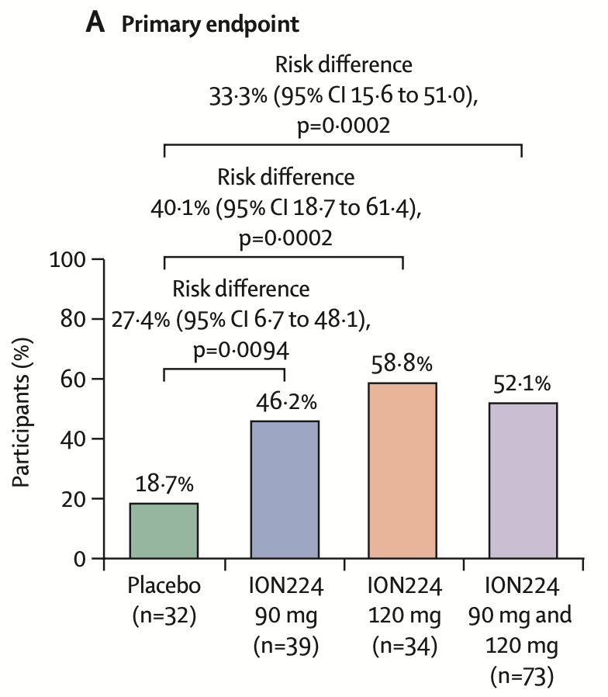
  Results
Improvement of MASH at week 51 without worsening fibrosis
Comparison Placebo with each ION224 group
Chi2 to compare placebo with each group
Or fisher when N < 5
Binomial regression to quantify the strength of difference
Presented with histogram
Results: difference observed between placebo and ION224
Placebo < ION224 90mg < ION224 120mg

Slide 6
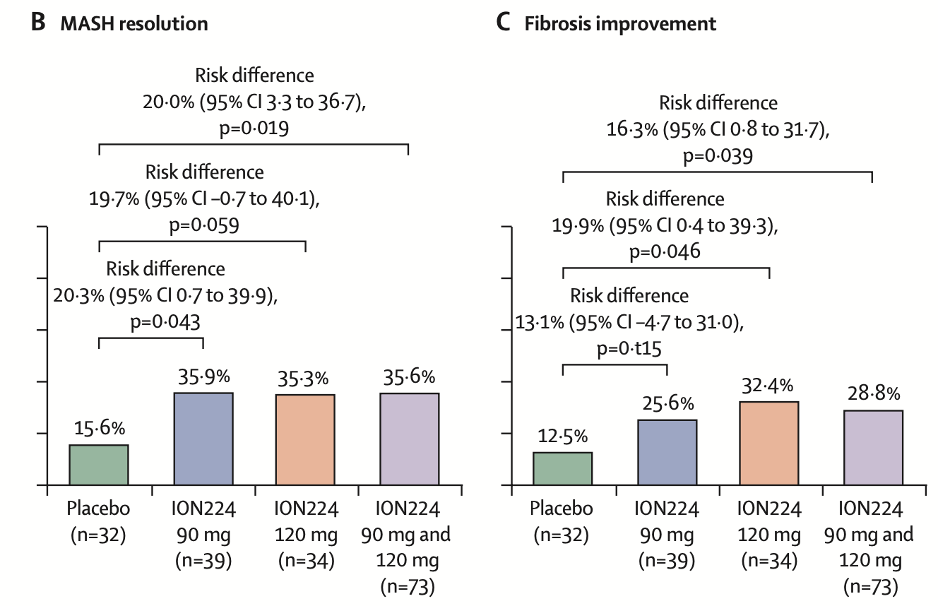
  Results
Secondary endpoints
MASH resolution and fibrosis improvement
For MASH : Significant for
90mg
Pooled 90 + 120mg
Not significant for 120mg
For fibrosis : Significant for
120mg
Pooled 90 + 120mg
Not significant for 90mg

Slide 7
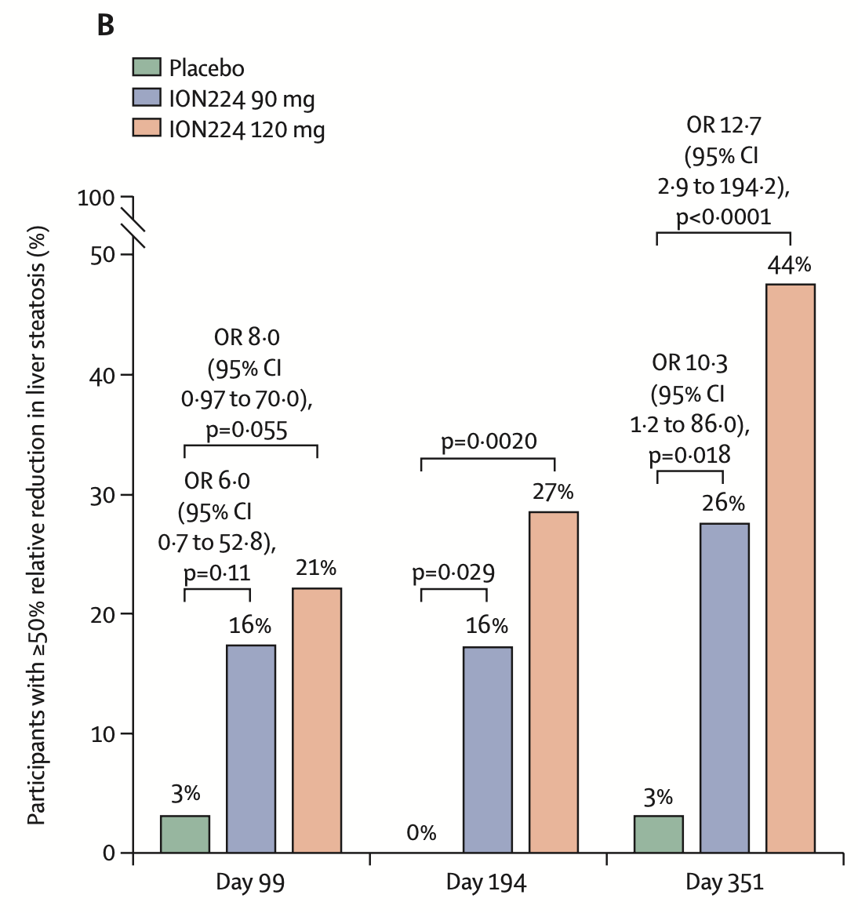
  Results
Secondary endpoints
Odds ratios (OR) for achieving ≥50% reduction in liver steatosis:
Day 99: Placebo < ION224 90 mg < ION224 120 mg
Day 351: Placebo < ION224 90 mg < ION224 120 mg
The effect increased over time, with higher odds at Day 351 compared to Day 99.
Dose effect
Time effect

Slide 8
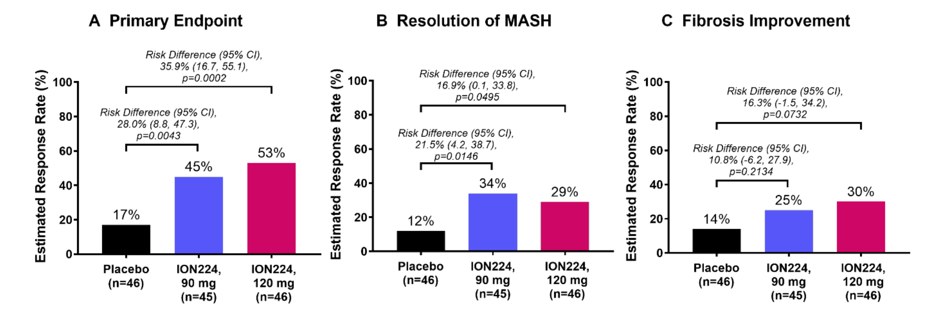
  Results
PEP and SEP still significative in ITT analysis
Missing liver biopsy data were imputed using J2R, assuming a placebo-like response.

Slide 9
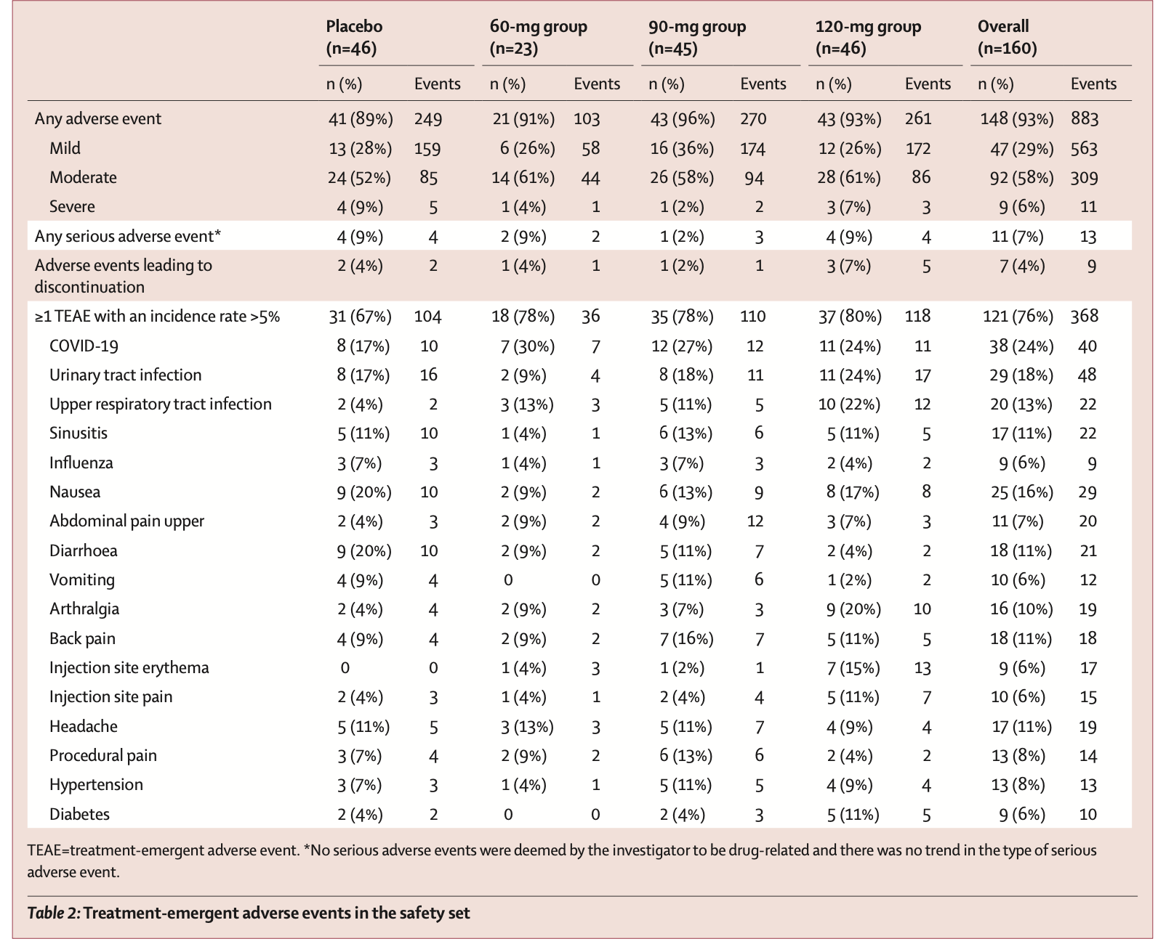
  Results
Safety analysis
Comparable AE rates vs placebo (94% vs 89%);
mostly mild-to-moderate injection site reactions
No deaths or treatment-related serious adverse events (SAEs)
No hypertriglyceridemia or worsening of lipid profile

Slide 10
  Discussion
Strengths of the trial:
-Adaptative design
-Randomized trial,
-Clear methodology
-Objective endpoints
-Statistically significant effect despite small sample
- Dose dependent effect
Key limitations of the trial:
-Small sample size → insufficient power for registrational endpoints (MASH resolution, fibrosis improvement) → But only a phase 2
- 23% of participants excluded from per-protocol analysis (missing biopsy or other reasons) → But still signif in ITT
-Study duration limited to 1 year → long-term histology/outcomes not assessed

Slide 11
  Conclusion
ION224-mediated DGAT2 inhibition leads to histological improvements, MASH resolution, and time-dependent reduction in hepatic steatosis, with a favorable safety profile.

